Slide 1
Secure Data Hiding in images using Steganography
CAPSTONE PROJECT
Presented By:-
Student Name :
College Name :
Department :
Ravikant Maurya
Ramanujan College(University of Delhi)
B.Sc.(Hons.)Computer Science

Slide 2
OUTLINE
Problem Statement
Technology used
Wow factor
End users
Result
Conclusion
Git-hub Link
Future scope

Slide 3
Problem Statement
With the increasing need for secure communication, traditional encryption methods alone may not be sufficient to protect sensitive data from cyber threats. Steganography offers a solution by concealing information within digital images, ensuring covert data transmission. This application aims to implement a robust steganographic technique to securely hide and retrieve data in images while maintaining their visual integrity. It will enhance data security, prevent unauthorized access, and provide a reliable method for confidential communication.

Slide 4
Technology used
Libraries:-
cv2 (OpenCV) – Used for image processing tasks like reading, modifying, and analyzing images.
os – Provides functions to interact with the operating system (e.g., file handling, directory management).
tkinter – A built-in Python library for creating graphical user interfaces (GUIs).
filedialog – A tkinter module for opening file selection dialogs.
messagebox – A tkinter module for displaying pop-up messages and alerts.
Toplevel – A tkinter class to create additional windows in the GUI.
scrolledtext – A tkinter widget providing a text area with a scrollbar.
PIL (Pillow) – Used for image handling, including opening, editing, and converting images.
Image, ImageTk – Submodules of PIL for image processing and rendering in Tkinter.
ttkbootstrap – A modern UI styling library for Tkinter, adding themed widgets for an enhanced look.
Platform:-
Visual Studio Code (VS Code) – A widely used code editor with features like debugging, extensions, and Git integration, making Python development efficient.

Slide 5
Wow factors
Password-Protected Encryption & Decryption:- Users must enter a passcode to encrypt and decrypt messages, enhancing security.
Real-Time Image Preview:- Selected images are displayed in the UI before encryption, allowing users to verify the image before embedding a message.
Stealth Pixel-Based Message Hiding:- The message is stored in RGB pixel values using a unique algorithm, making it difficult to detect through regular analysis.
Scrollable Decrypted Message Display:- Decrypted messages appear in a separate pop-up window with a scrollable text box, ensuring long messages can be easily read.
Modern UI with Themed Bootstrap Styling:- The application uses ttkbootstrap for a sleek, user-friendly interface with a professional look.
Secure Image Handling:- The encrypted image is saved as a new file (encryptedImage.png) to prevent overwriting the original image.
Message Capacity Management:- A built-in error check prevents messages that exceed the image’s capacity from being encrypted.
Drag-and-Drop Image Selection (Future Enhancement):- Planned feature to allow users to drag and drop an image into the application for a seamless experience.
Encryption & Decryption Status Updates:- Real-time status messages inform users about encryption or decryption success or failure.
Lightweight & Fast Processing:- Optimized OpenCV and Tkinter integration ensures quick message embedding and extraction without lagging.

Slide 6
End users
🔐 1. Cybersecurity Enthusiasts & Ethical Hackers :- People learning about steganography and data hiding for security research. Useful for penetration testers to understand covert communication techniques.
👨‍💻 2. Developers & Researchers :- Those working on data encryption, image processing, and secure communication applications. Can be integrated into bigger security projects.
🕵️‍♂️ 3. Journalists & Whistleblowers :- To securely share sensitive information without detection. Hidden messages can be stored inside images and shared publicly without suspicion.
🔒 4. Privacy-Conscious Individuals :- People who want to protect private messages from being intercepted. Useful for sending personal data covertly over public channels.
📚 5. Students & Educators :- A great learning tool for students exploring cryptography and steganography. Can be used in university projects related to computer security and image processing.
🏛️ 6. Intelligence & Government Agencies :- Could be adapted for covert communication or secure intelligence sharing. Law enforcement can study it to detect hidden data in cybercrime investigations.
🚀 7. Digital Forensics Experts :- Can analyze encrypted images to test data recovery methods. Helps in cybercrime investigations to detect illegal message hiding techniques.

Slide 7
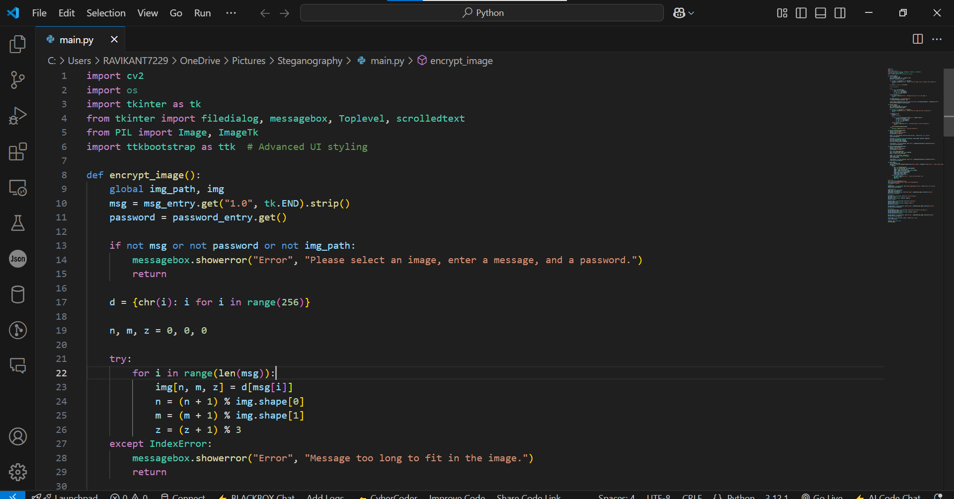
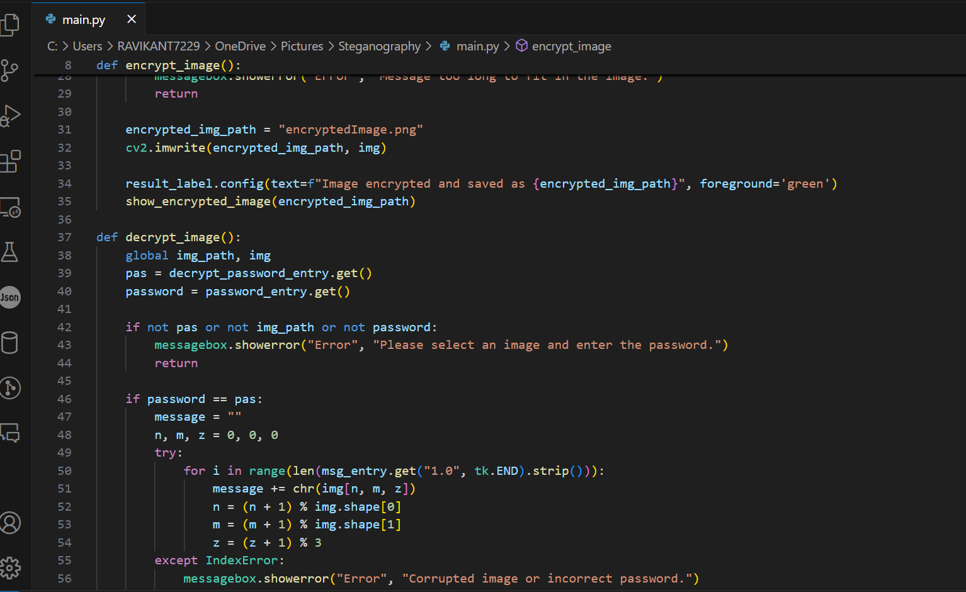
Code

Slide 8
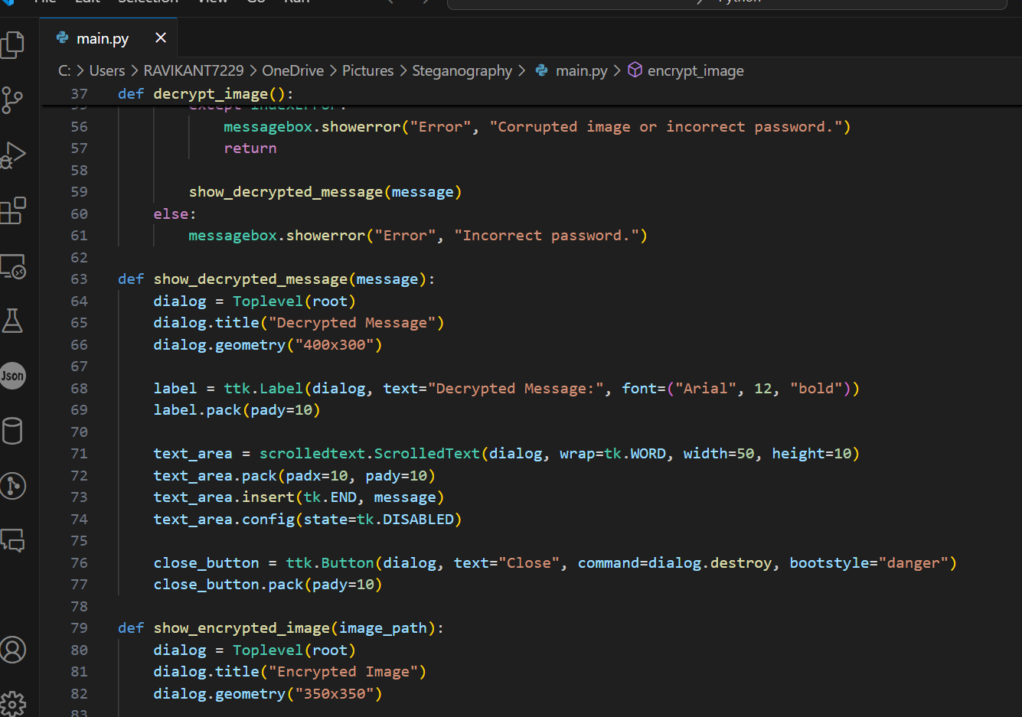
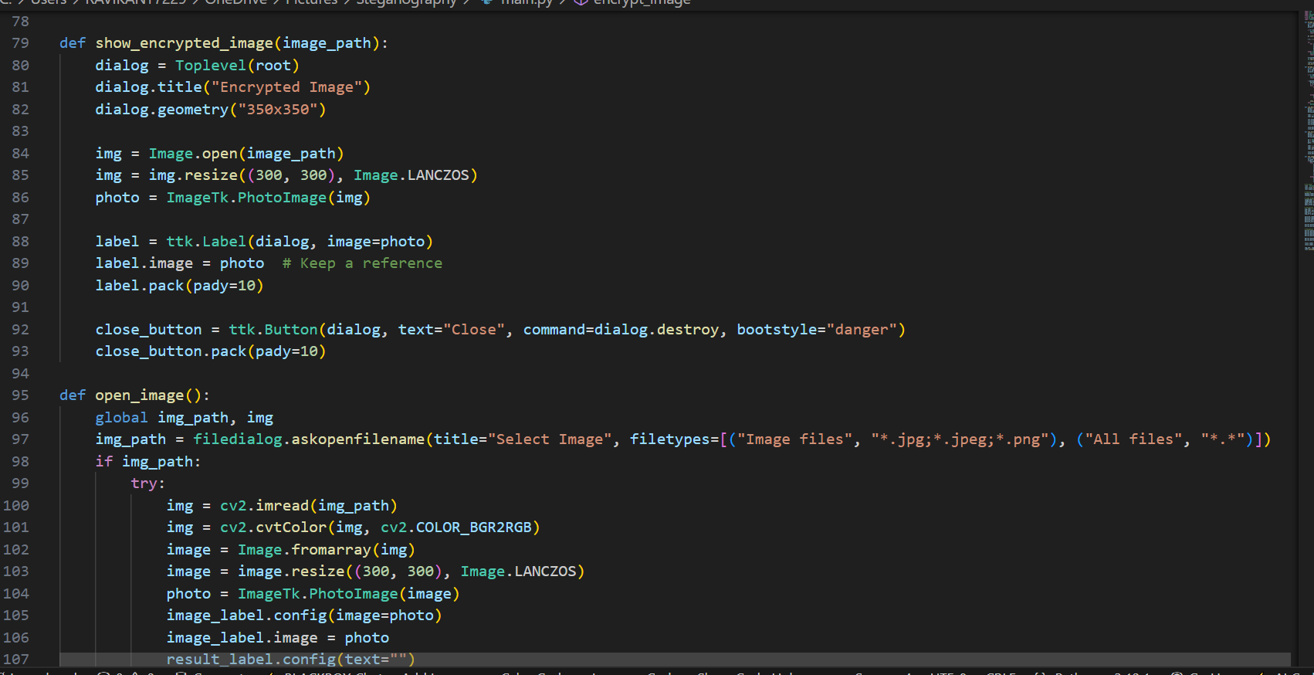

Slide 9
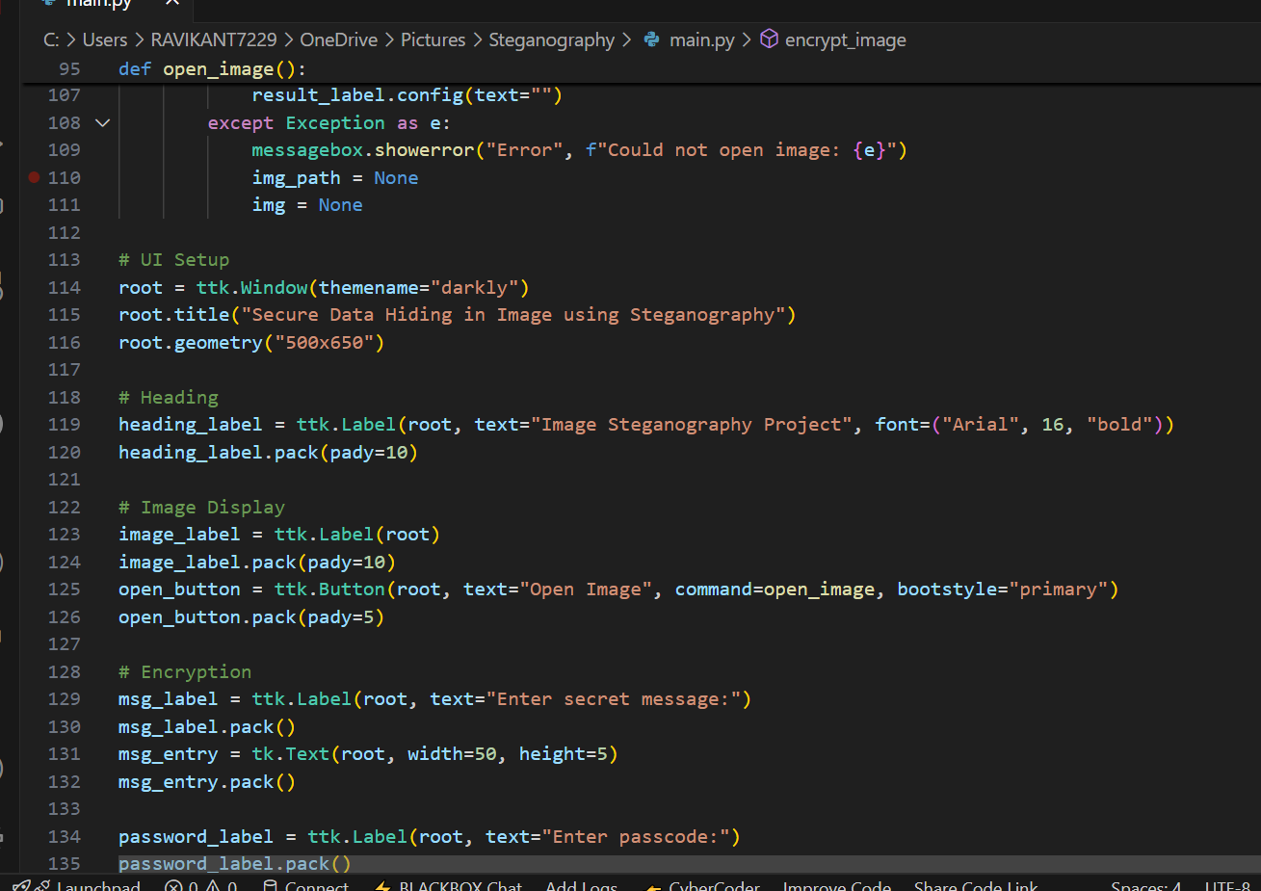
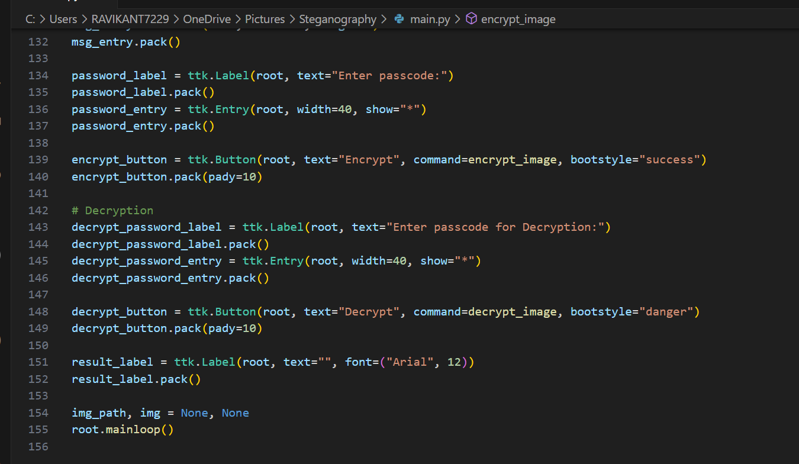

Slide 10
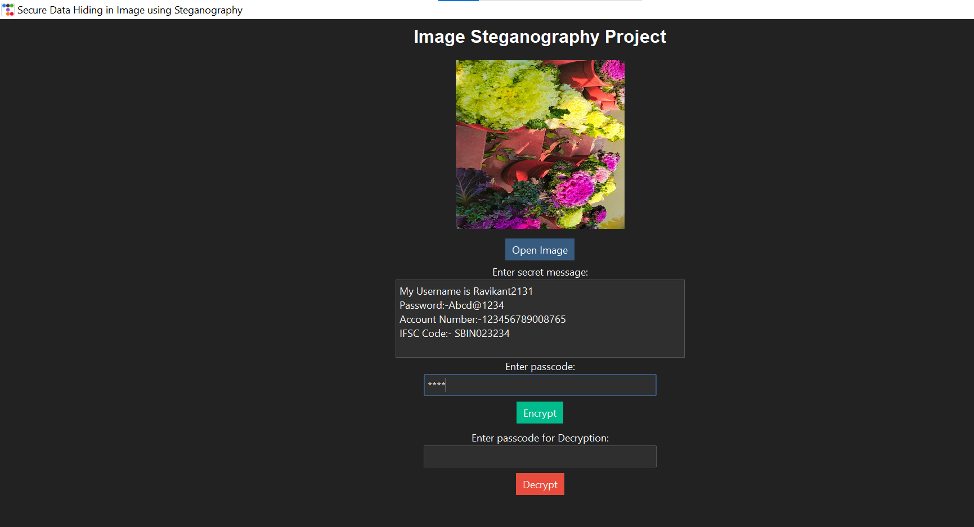
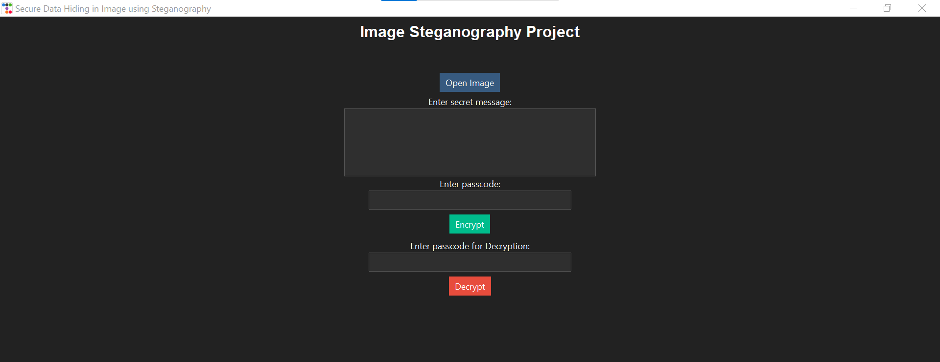
Results

Slide 11
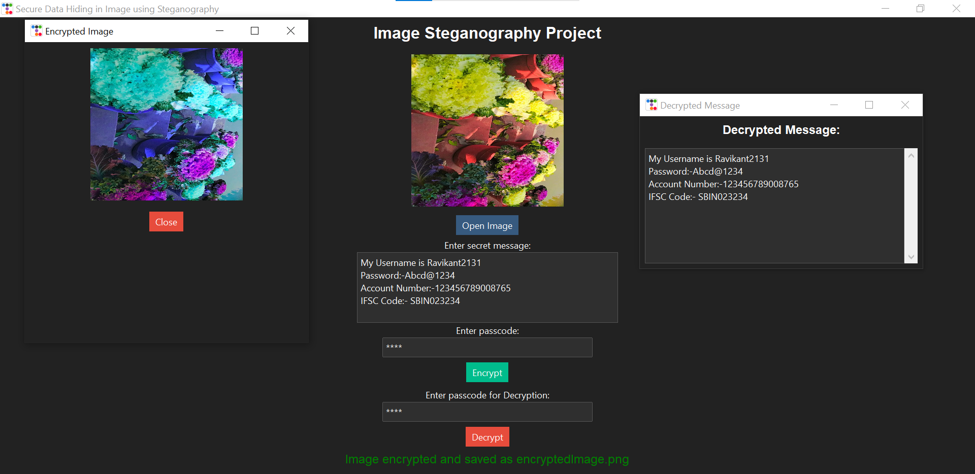
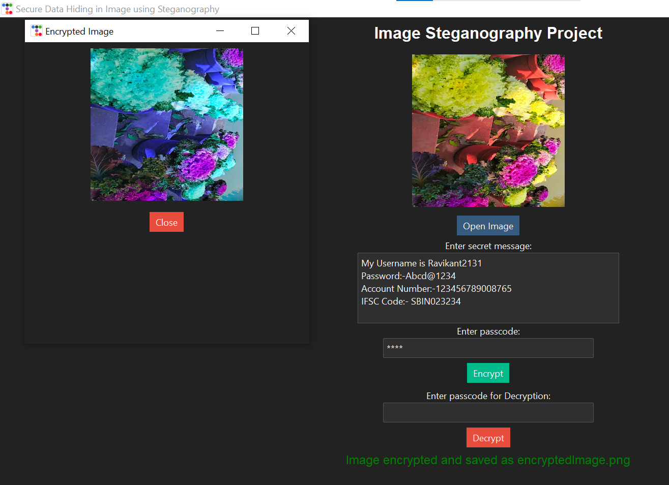

Slide 12
Conclusion
The Image Steganography project successfully implements the technique of hiding secret messages within images using LSB (Least Significant Bit) encoding. By leveraging Python, OpenCV, Tkinter, and TtkBootstrap, the project provides a user-friendly GUI for encoding and decoding hidden text within images.
This tool enhances data security by allowing covert communication while maintaining the original image’s visual integrity. The integration of OpenCV ensures efficient image processing, while Tkinter and TtkBootstrap improve usability with an intuitive interface.
Future improvements may include adding encryption for additional security, supporting multiple image formats, and implementing adaptive steganography techniques to further enhance robustness. This project demonstrates a practical application of steganography in the field of cybersecurity and secure communication.

Slide 13
GitHub Link
Github ID:- ravikantmaurya00
Github Repository Link:- https://github.com/ravikantmaurya00/Steganography-Image-Encryption-Decryption

Slide 14
Future scope(optional)
Enhanced Security with Encryption :- Integrate AES or RSA encryption to encrypt the message before embedding it in the image. This ensures that even if extracted, the hidden data remains unreadable without a decryption key.
Support for Multiple Image Formats :- Extend support to JPEG, BMP, and GIF for better usability. Implement lossless techniques for JPEG, which uses lossy compression.
Advanced Steganography Techniques :- Use Edge-Based or DCT/DWT frequency-domain steganography for improved invisibility. Apply AI/ML-based approaches to enhance the robustness of hidden data.
Higher Data Capacity & Optimization :- Optimize encoding efficiency to store more data without noticeable changes in image quality. Implement dynamic LSB techniques to adapt encoding depth based on the image’s structure.
Mobile & Web-Based Implementation :- Develop a mobile app using Kivy (Python) or Flutter for secure on-the-go usage. Create a web-based tool (Flask/Django + JavaScript) for online steganography.
Expansion to Audio & Video Steganography :- Implement audio steganography to embed messages within sound waves. Develop video steganography, spreading hidden data across multiple frames.
Steganalysis Resistance :- Apply randomized bit encoding instead of simple LSB to avoid detection. Use anti-detection algorithms to counter steganalysis tools.

Slide 15
Thank You

